Slide 1
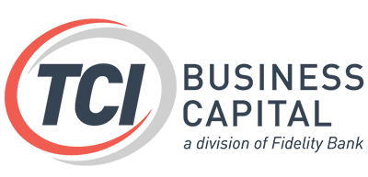
2Q Reality Check
Are you on track to reach your 2021 Growth Goal?
3 Key Performance Questions every Staffing Owner should ask themselves

Slide 2
Are you on track to reach your 2021 growth goal? Now is the time to make meaningful adjustments
Three Questions to Ask Yourself….
What is your Growth Strategy?
Is your business positioned for growth?
Are you working on the business?

Slide 3
Sheri brings to her role at TCI Business Capital over 15 years of front-line staffing experience and has an authentic passion for the industry. She is responsible for developing staffing industry partnerships and driving our payroll funding solutions throughout the nation. Sheri’s leadership experience and understanding of sales, recruiting, and operations in the staffing industry allow her to speak the language of staffing industry owners to better assist them in getting their financial needs met. She is a member of the ASA Mentorship program and active with NAWBO-MN.
Sheri Tischer
VP of Business Development TCI Business Capital

Slide 4
Michael has over 35 years of sales and sales management experience in both large and small organizations, emphasizing improving sales. He has a unique blend of sales and operational experience in leading organizations to grow their business by implementing the best practices that separate high-performing organizations from their peers'. Michael's responsibilities include managing a sales organization and supporting TCI's Strategic Alliance initiatives
Michael Holland
Sr. VP Sales and Strategic Alliance TCI Business Capital

Slide 5
What is your Growth Strategy?
Reexamine your goal
Do you really know your ideal client?
Are sales and recruiting trained and aligned?
What differentiates you?

Slide 6
Reexamine your growth goal
*How was the goal established?
*What assumptions were used to determine the goal?
*What objectives and measurement were established?
*Is there alignment throughout the organization?
Your ideal client
*Is your ideal client clearly defined, including what makes them ideal?
*Is your ideal client clearly understood throughout your organization?
*Do 80-85% of your prospects align with your ideal client?
*Disqualifiers / what is not an ideal client and why?

Slide 7
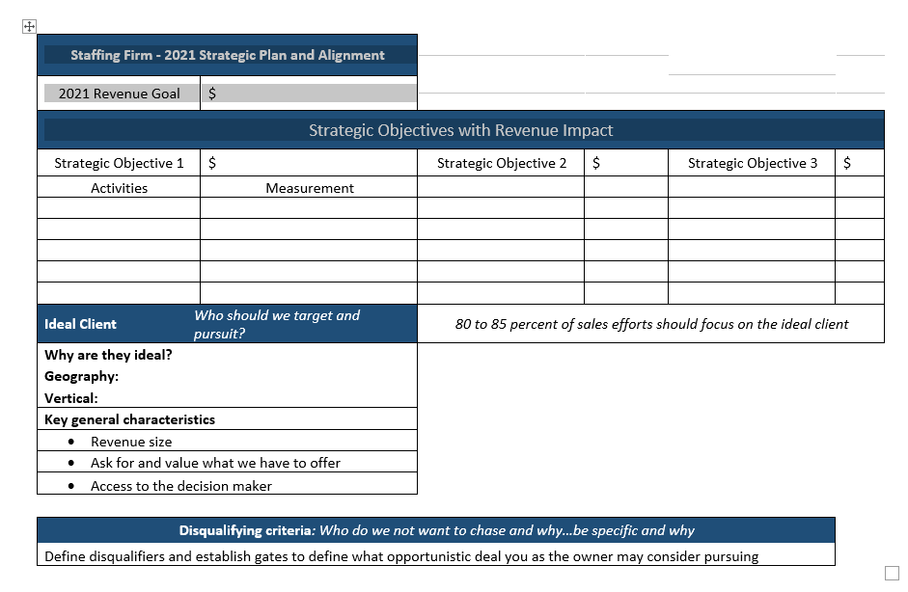

Slide 8
Are sales and recruiting trained and aligned?
* Team Alignment
General staffing vs specialty staffing
6x6 strategy
* Training
Sales – coaching clients on things such as pay rates
Recruiters – language to encourage return to work
* Engagement
8-10 touches now requires 18-22 touches + continued engagement
What differentiates you?
* Candidate, Employee and Client experience
Processes / Communication / Customer Service
* Six Common Denominators of “Great” companies.
One is, Attention to Detail
* Value Add Services
Lunch and Learns, Blogs, Newsletters

Slide 9
Is your business positioned for growth?
Potential weak link constraints:
Scalability – the ability to grow without being hampered by your structure or available resources when faced with increased production
Back office support limitations
Working capital – are you passing up business due to cash flow constraints?

Slide 10
Working Capital Options for Staffing Firms
Self fund
Bank line of credit
Payroll funding – leveraging your Accounts Receivables

Slide 11
Payroll Funding FAQ’s
Do I need to sign a contract?
Answer: Yes. It is essential to review the terms before signing on with a payroll funding company. As a customer, flexible terms are ideal. Most companies only offer a one-year (or more) agreement. At TCI Business Capital we offer month to month contracts, so you are never locked into a long-term agreement.
Do I lose control over my billing and posting?
Answer: No. You are in control of your invoicing. You may invoice your customer or have the option to have the payroll funding company send the invoice on your behalf.
Do I need to fund all of my invoices, or can I pick and choose?
Answer: You may choose which invoices you want to finance and when. However, once you decide to fund one of your accounts, most accounts receivable financing companies will generally require you to fund all of the invoices for that customer in order to reduce payment confusion.
Can I qualify for funding if my personal or business credit is less than ideal?
Answer: Most funding companies are more interested in your customer’s creditworthiness than your time in business. If they have a good record of paying you, that will work to your advantage in the approval process.
Can I use a funding company if I have PPP $$?
Answer: In most cases, yes. For a funding company to finance your invoices, they will need to have ownership rights of the receivables. An arrangement can usually be worked out that will enable subordination of the receivables.

Slide 12
Are you working ON the business?
Where are you spending your time?
Which tasks make sense to out task?
You do what you do best – let others do what they do best…..
Credit/AR Management
Payroll Processing
HR Compliance

Slide 13
THANK YOU for attending 2Q Reality Check
What is your Growth Strategy?
Is your business positioned for growth?
Are you working on the business instead of in the business?
QUESTIONS?

Slide 14
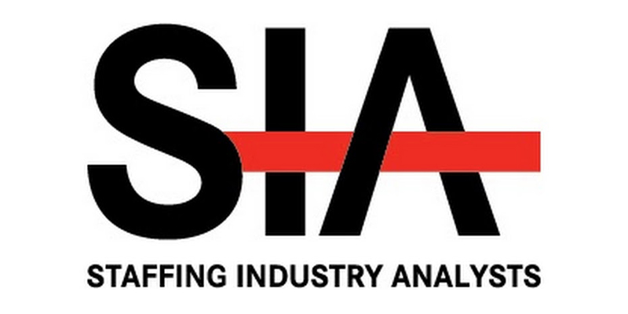
We’ve Got Your Back… Office Support
Payroll Funding
Payroll Processing
Staffing Software
For more information contact - Sheri Tischer or Michael Holland
952.656.3492
stischer@tcicapital.com
952.656.3478
mholland@tcicapital.com
www.tcicapital.com
Proud members of:

